Slide 2

Is ‘Autism’ a Disorder!
It is a Neurodevelopment Disability.
Mostly occur in the age of 2-3 years in children.
Affects child mentally.
Results in lack of Social Interactions, Behavior and Communication.
These kids keep their intense focus on only a particular thing.

Slide 3

Reaction of Society on ‘Autism’
Autism is considered as Disorder.
Over-caring over-rules the Symptoms.
People are not aware about it.
Parents feel embarrassed with their kids in the society.
“Autism is not a tragedy, ignorance is”

Slide 4

Prevalence of 'Autism'
Autism affect approximately 1 in 60 children. Boys are 4 times more likely to be diagnosed
with autism than girls. The prevalence has been increasing in recent years.

Slide 5
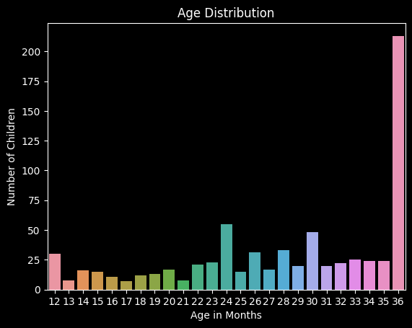

Slide 6
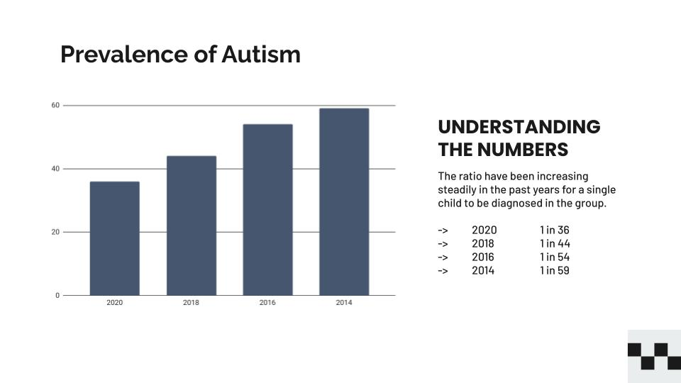
Source – www.cdc.gov

Slide 7

‘Autism' Screening
Screening for autism involves various methods such as questionnaires, observations, and interviews. However, these methods can be time-consuming and may require multiple visits. Our AI-powered project uses Machine Learning Algorithms to analyze data and make screening more efﬁcient and faster.

Slide 8
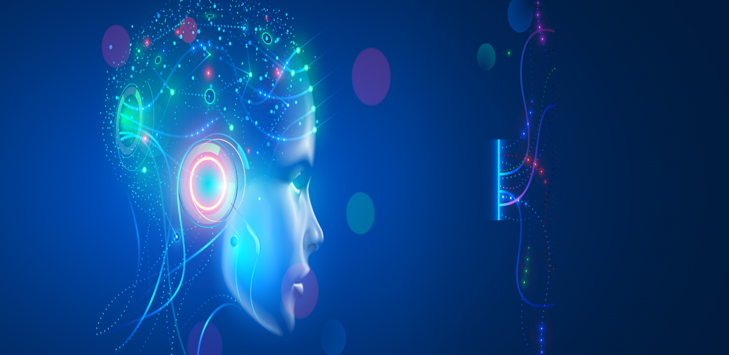
How Machine Learning is implemented on ‘Autism’ for Predictions..

Slide 9
Question Set For Judging
Q 1. Does your child look at you when you call his/her name ?
Q 2. How easy is it for you to get eye contact with your child ?
Q 3. Does your child point to indicate that s/he wants something ?
Q 4. Does your child point to share an interest with you ?
Q 5. Does your child pretend? e.g. care for dolls, talk on a toy phone ?
Q 6. Does your child follow where you are looking ?
Q 7. If you or someone else in the family is visibly upset, does your child show signs of waning to comfort them ?
(e.g. stroking hair, hugging them)
Q 8. Would you describe your child's first word as ?
Q 9. Does your child use simple gestures (e.g. wave, goodbye) ?
Q 10. Does your child stare at nothing with no apparent purpose ?

Slide 10
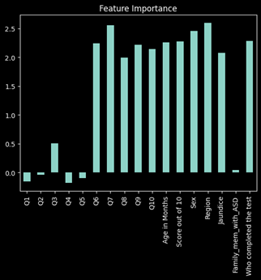
z

Slide 11
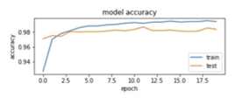
Model Accuracy
This Machine Learning Model gives the most accurate prediction efficiently.
It is independent of factors including Region, Gender etc.

Slide 12
Time for some live testing...

Slide 13

Advantages of Machine Learning
Faster Diagnostic.
Reduced need of multiple visits.
Reduce Stress.
Early Detection helps in resolving the problem

Slide 14
Conclusion
Our AI-powered project for autism detection has the potential to revolutionize the way we diagnose and treat individuals with autism. By providing efﬁcient, accurate, and early detection, we can improve outcomes and quality of life for individuals and families. We are excited to continue our work and make a positive impact in the ﬁeld of 'Autism'.
“Autism is not a puzzle, but a mosaic, every piece is different, yet beautiful in its own way”

Slide 15
Thanks! Questions are Welcomed
Presented By-
Kamlesh Baheti
Kartik Dehru
Charu Goswami
Vivek Kumar Singh

